Slide 1
BREAST CANCER DETECTION USING ADABOOST CLASSIFIER
~ Enhancing Early Diagnosis with Machine Learning Techniques
TEAM 1

Slide 2
What is Breast Cancer?
Breast cancer is a kind of malignant growth of cells starting with breast tissue, usually in the interior lining of the Breast Lobules or Milk Ducts and metastasizing to other body parts.
The second most widespread disease worldwide is breast cancer. It can be classified into two main types:
Malignant
Benign

Slide 3
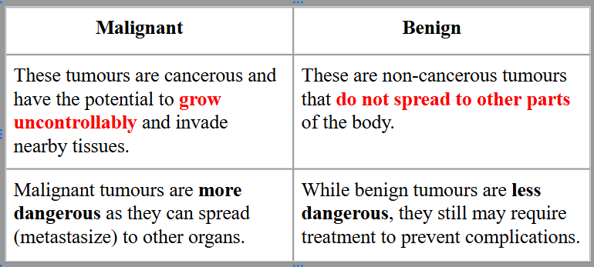
Types of Tumors

Slide 4
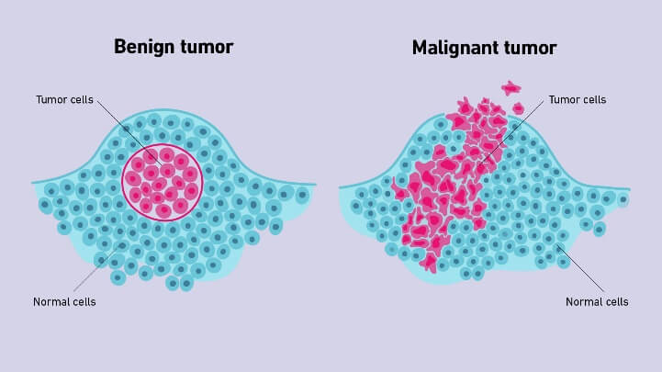
Types of Tumors

Slide 5
Why we need a machine learning based solution?
Improved Accuracy: Detects patterns in medical data, reducing false positives and negatives.
Faster Analysis: Handles large, complex datasets efficiently for quicker results.
Early Detection: Identifies subtle signs, enabling timely treatment.
Personalized Care: Tailors recommendations based on patient-specific data.
Scalability: Deployable in diverse healthcare settings, including remote areas.
Consistency: Provides unbiased, fatigue-free analysis compared to manual methods.
Continuous Learning: Improves with new data, staying updated with advancements.
Machine learning enhances diagnostic precision, saves time, and improves patient outcomes.

Slide 6
Ensemble techniques & its various types
Ensemble techniques are a set of powerful methods in machine learning that combine predictions from multiple models to improve overall accuracy, robustness, and generalization. Instead of relying on a single model, ensemble methods aggregate the outputs of several models to reach a more accurate and reliable prediction. This approach is particularly beneficial in complex problems where individual models might struggle to provide optimal results.
Types:
->Bagging:A technique where multiple independent models are trained on random subsets of data with replacement, reducing variance and avoiding overfitting.
->Boosting:Models are trained sequentially, where each new model attempts to correct errors made by previous ones, focusing more on misclassified data.
->Stacking:Combines the predictions of multiple models (base learners) using a meta-model to achieve better generalization.

Slide 7
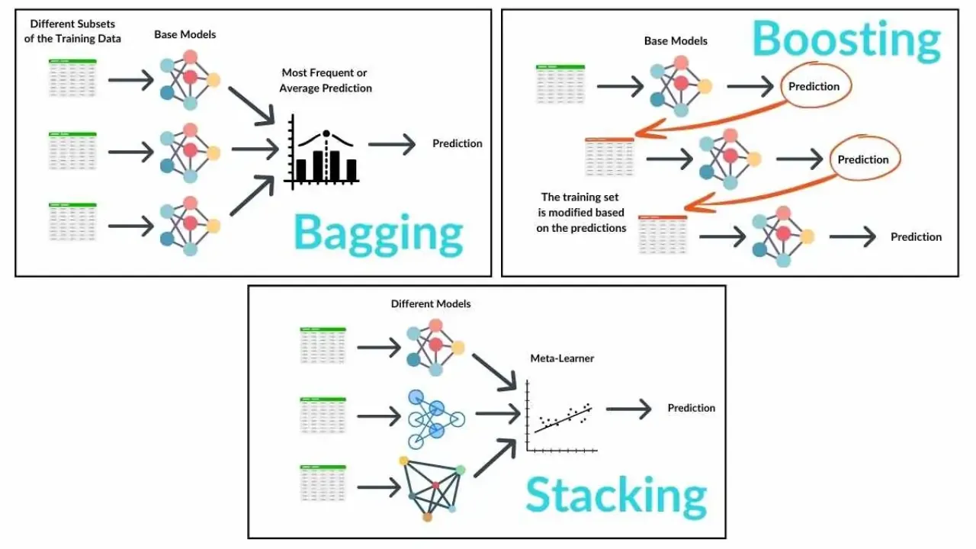

Slide 8
Why AdaBoost? A Smart Choice for Breast Cancer Diagnosis
AdaBoost is a “Boosting” ensemble technique that combines weak classifiers to form a strong classifier.
AdaBoost builds models by adjusting the weight of each data point so that more focus is given to the samples misclassified by previous models
-> Focus on Misclassified Samples -> High Accuracy and Interpretability
-> Efficiency with Less Overfitting

Slide 9
Exploratory Data Analysis (EDA)
Exploratory Data Analysis (EDA) is the process of analyzing and visualizing a dataset to summarize its main characteristics, often using statistical and graphical techniques.
The goal of EDA is to uncover patterns, identify anomalies, test hypotheses, and check assumptions before applying machine learning models.
It helps to better understand the data, clean it, and prepare it for further analysis or modeling.
Common EDA tasks include examining distributions, relationships between variables, missing values, and outliers using tools like histograms, scatter plots, box plots, and correlation matrices.

Slide 10









Dataset : UCI Breast Cancer Wisconsin dataset
Data Pre-processing
Loading of Data
Given Title for each Columns
EDA
Head
Tail
Info
Shape
Describe

Slide 11
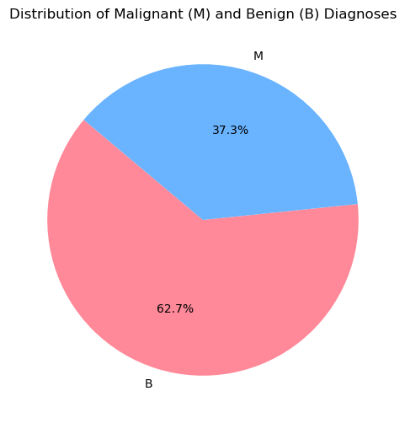
Pie chart
Data Imbalance is there , therefore SMOTE is needed

Slide 12
Why SMOTE is Applied
Imbalanced Dataset: Breast cancer datasets often have more benign (negative) cases than malignant (positive) cases, leading to poor model performance for detecting malignant cases.
SMOTE (Synthetic Minority Over-sampling Technique):
Generates synthetic samples for the minority class (malignant), balancing the dataset.
Impact: Improves model's ability to correctly identify malignant tumors.
Benefit: Higher recall and better overall classification performance for rare classes (malignant).

Slide 13
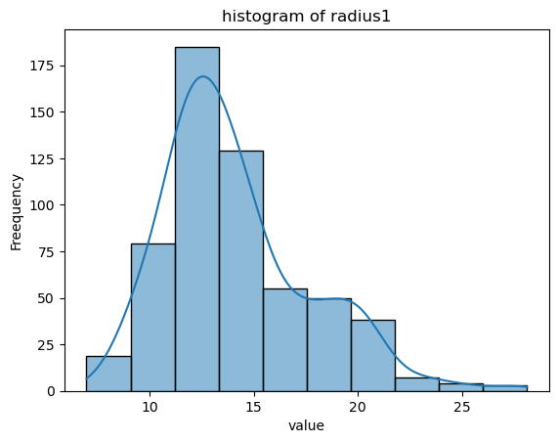
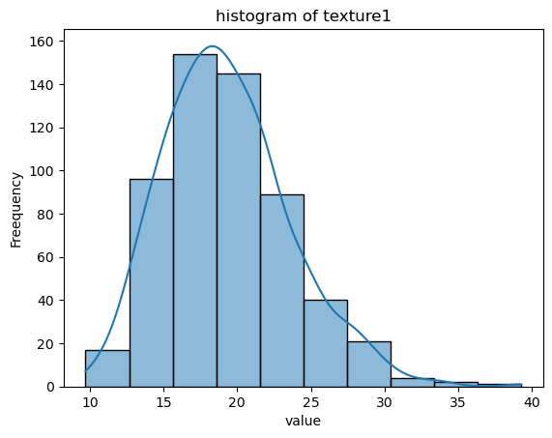
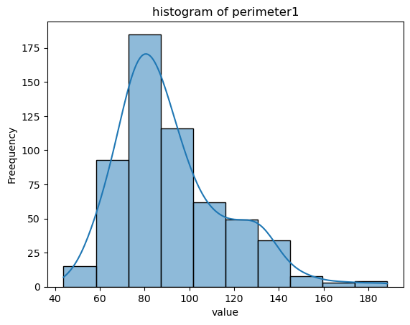
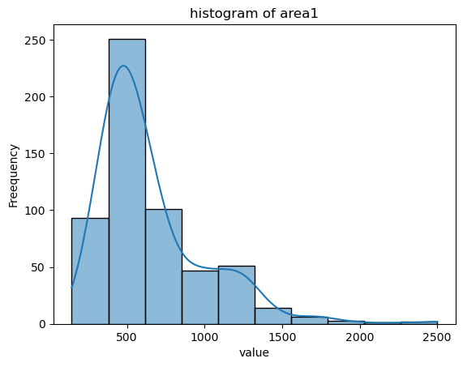
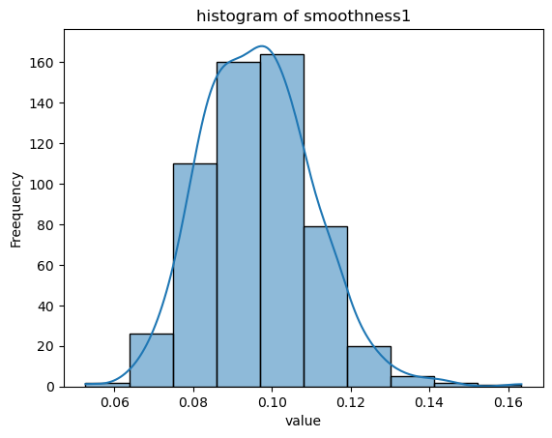

Slide 14
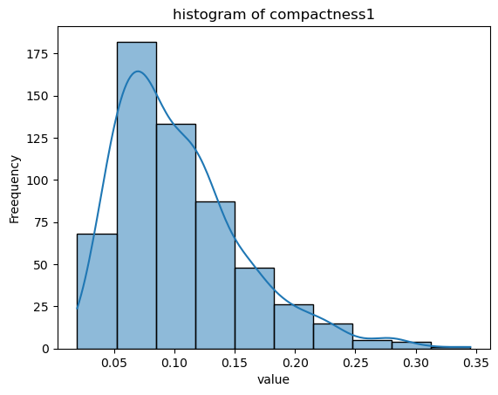
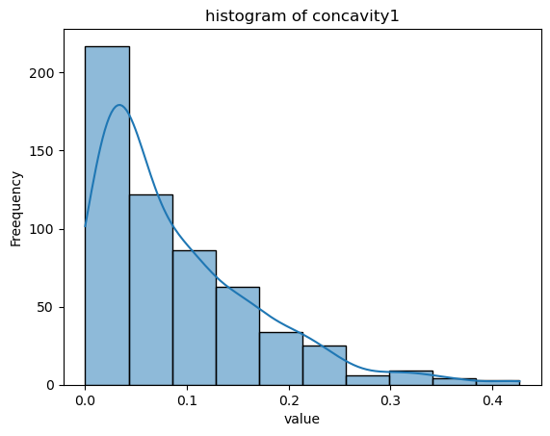
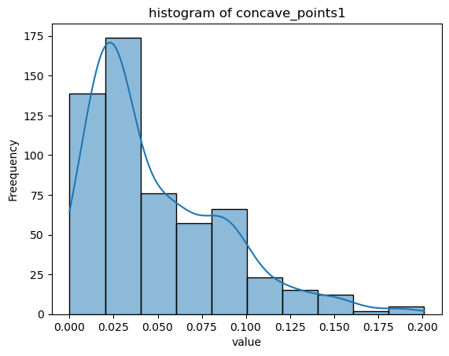
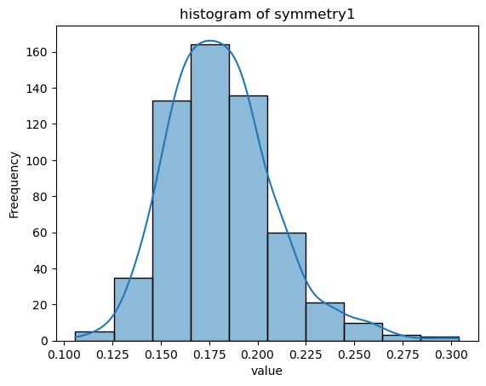
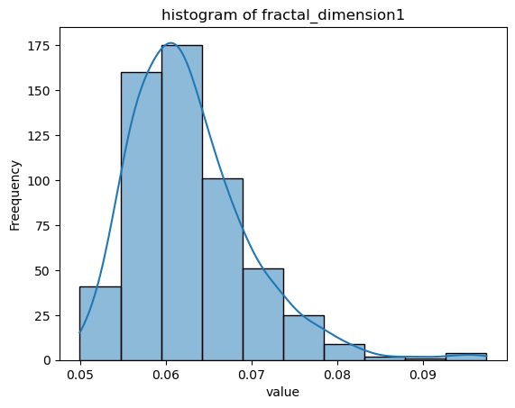
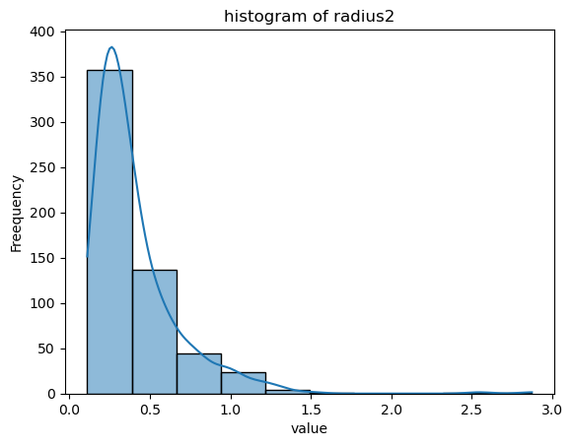

Slide 15
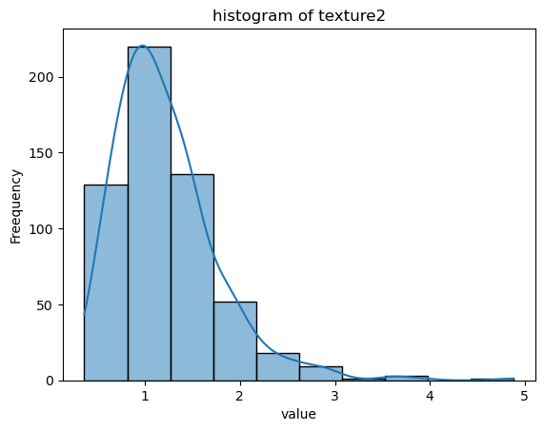
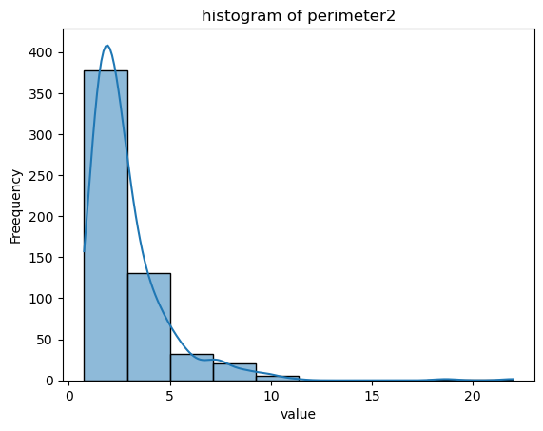
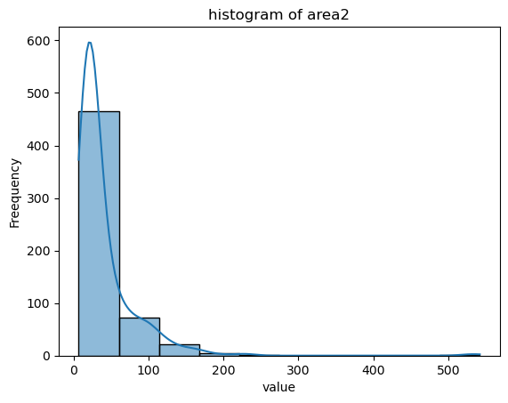
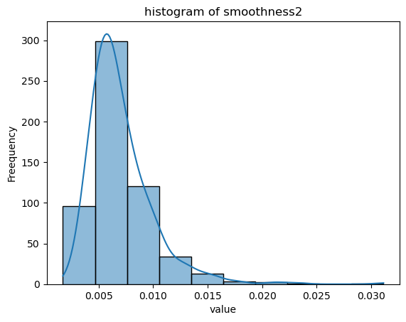
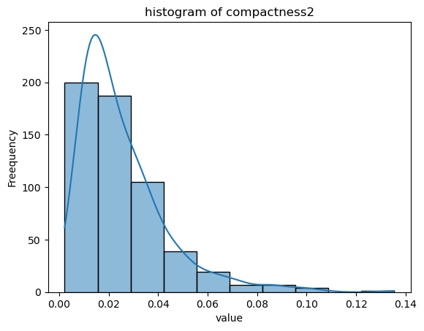
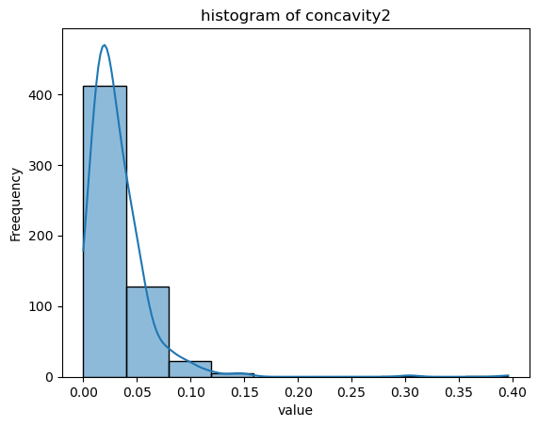

Slide 16
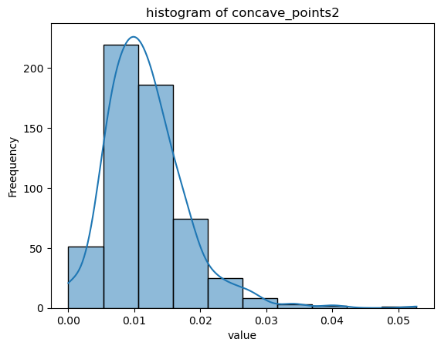
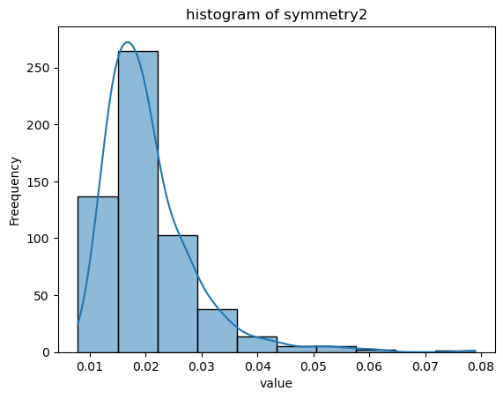
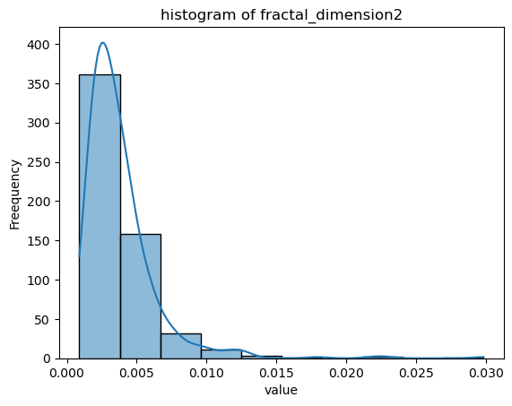
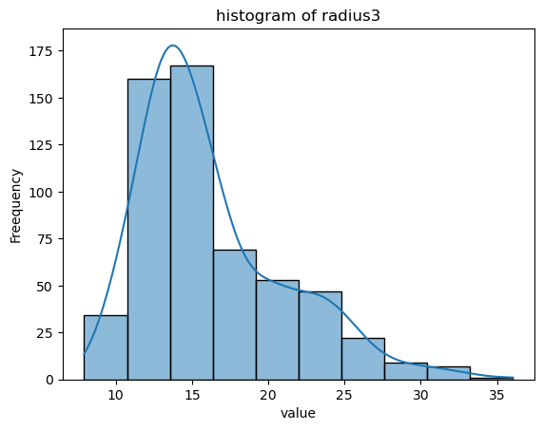
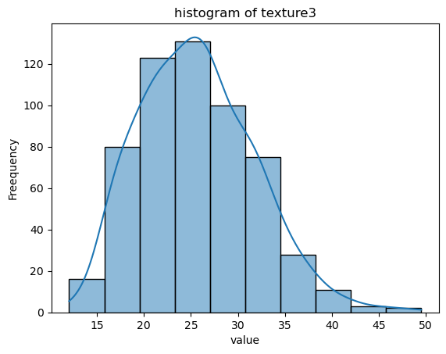
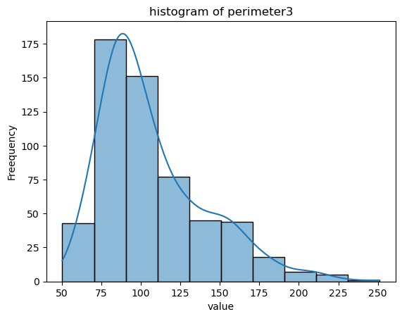

Slide 17
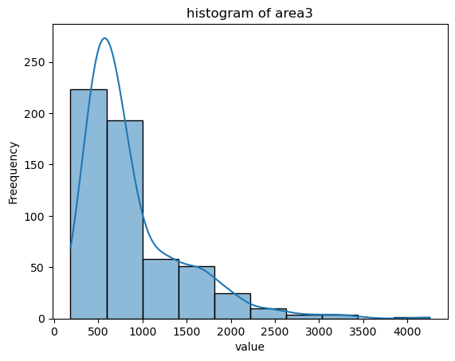
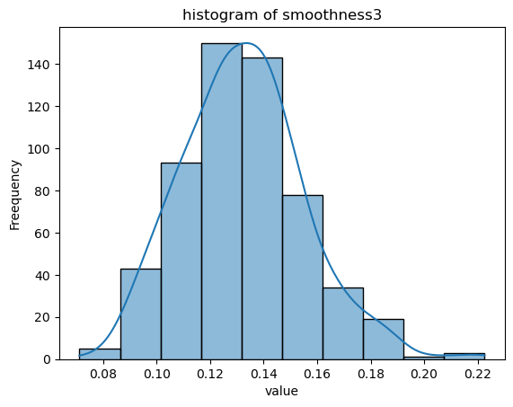
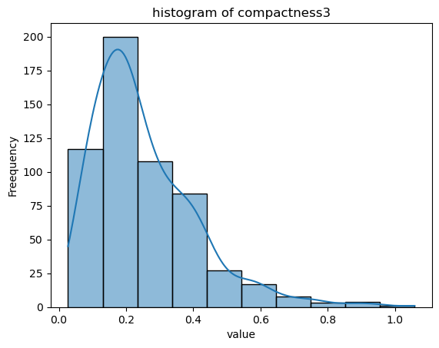
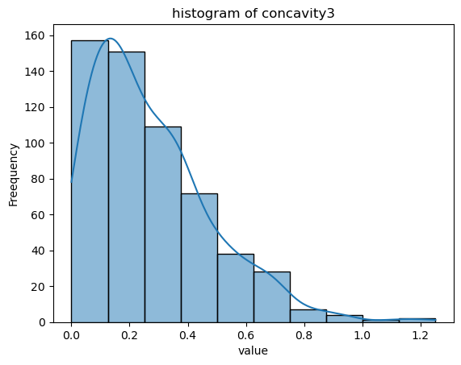
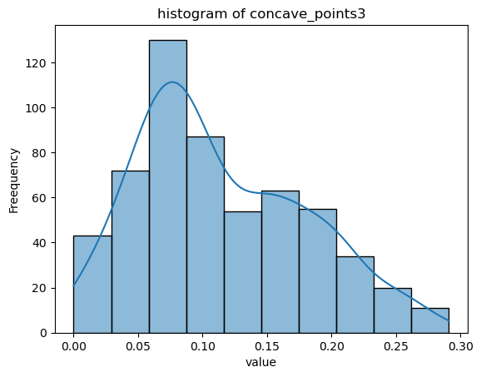
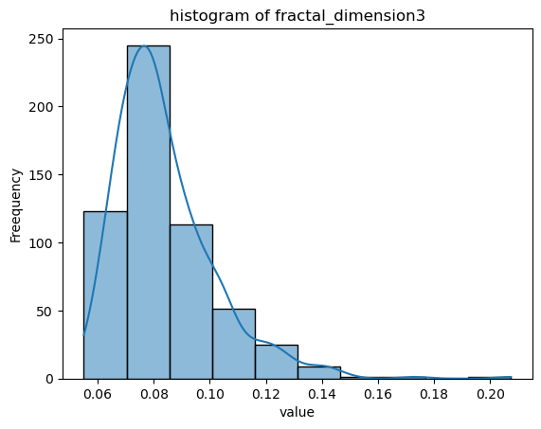

Slide 18
From the distribution graph we can see that the distribution is either, right skewed or near normal
Therefore Standard Scaling Can be applied

Slide 19
Training the Model
Model Selection:
We use multiple machine learning models to compare their performance on breast cancer detection:
AdaBoost
Logistic Regression (LR)
Decision Tree
Random Forest
XGBoost
Data Versions:
Raw Data: Model trained on the original, unprocessed dataset.
With SMOTE: SMOTE applied to generate synthetic data for the minority class.
Procedure: Split the dataset into training and testing sets (70% train, 30% test) for evaluation.

Slide 20
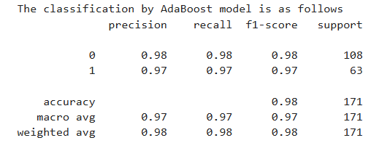
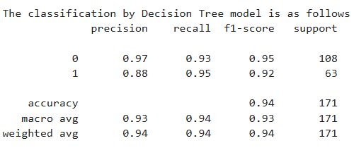
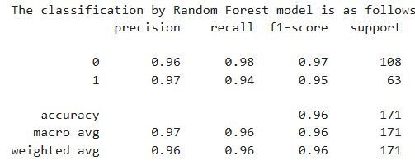
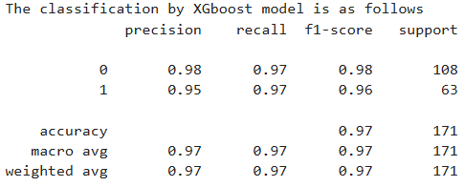
NO SMOTE

Slide 21
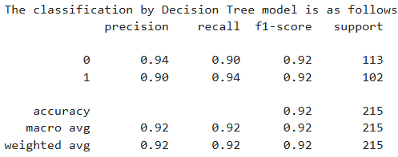
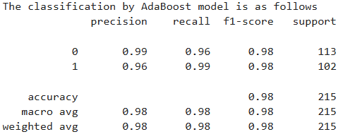
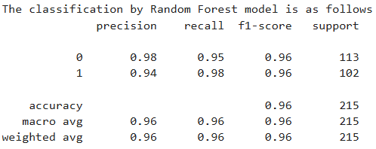
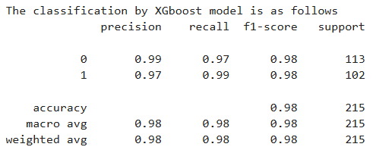
SMOTE

Slide 22
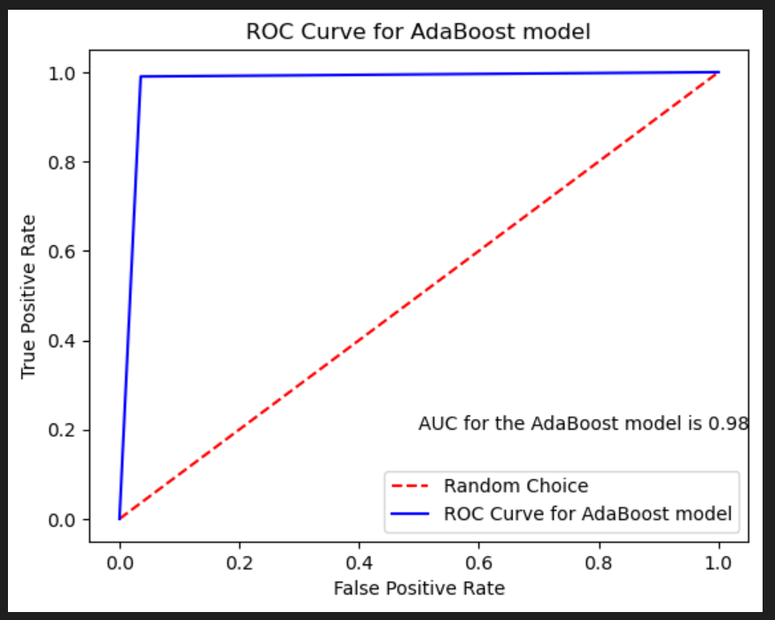
Performance Analysis using AdaBoost Model with SMOTE

Slide 23
Comparing AdaBoost with Other Models
Overview of Results:
Each model was trained and evaluated on both raw and SMOTE-applied datasets.
AdaBoost showed superior performance compared to other models, particularly with SMOTE-applied data.
Metrics Analyzed:
Classification Report: Precision, recall, and F1-score for each model.
ROC Curve & AUC: Used to assess performance; AdaBoost with SMOTE yielded the highest AUC.
Conclusion: AdaBoost with SMOTE performed best, showing strong classification metrics and a high AUC.

Slide 24
Hyperparameter Tuning
Why Hyperparameter Tuning?
Improves model performance by finding the optimal set of hyperparameters.
GridSearchCV used for tuning AdaBoost, selecting the best parameters for better accuracy.
AdaBoost Hyperparameter Tuning:
Parameters like learning rate, number of estimators, and max depth were tuned.
Benefit of Hyperparameter Tuning:
Fine-tuning significantly enhanced the model’s ability to correctly classify malignant cases, reducing false negatives.

Slide 25
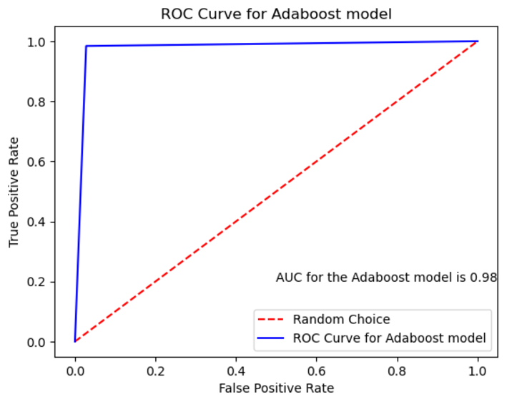
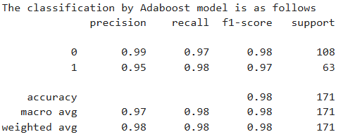
Performance Analysis using AdaBoost Model after hyperparameter tuning without SMOTE
Outcome: Improved accuracy to 98%, with excellent precision and recall.

Slide 26
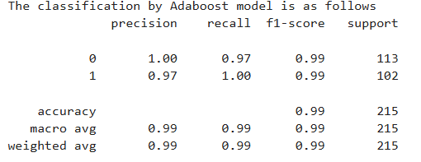
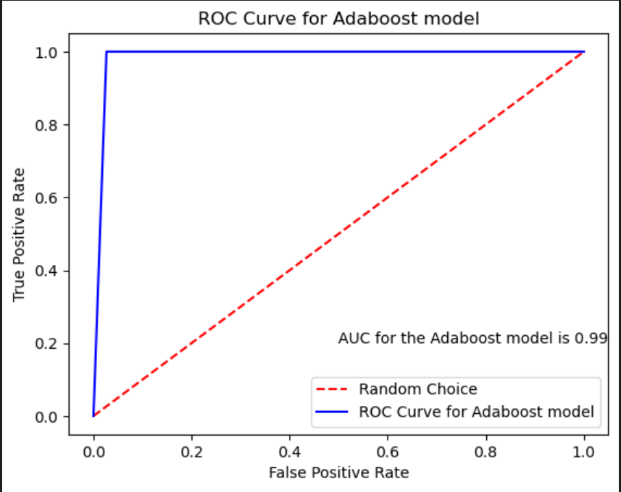
Performance Analysis using AdaBoost Model after hyperparameter tuning with SMOTE
Outcome: Improved accuracy to 99%, with excellent precision and recall.
Final Model Choice:
AdaBoost with SMOTE is chosen as the final model due to its excellent performance on both balanced and imbalanced datasets, aided by hyperparameter tuning.

Slide 27
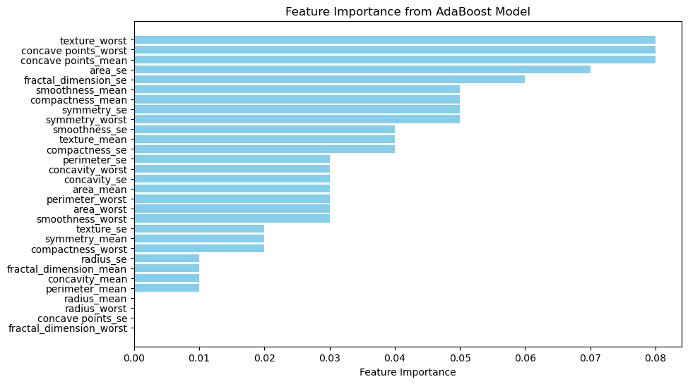
A Cut off of .03 is used for Variable selection
Data With Smote

Slide 28
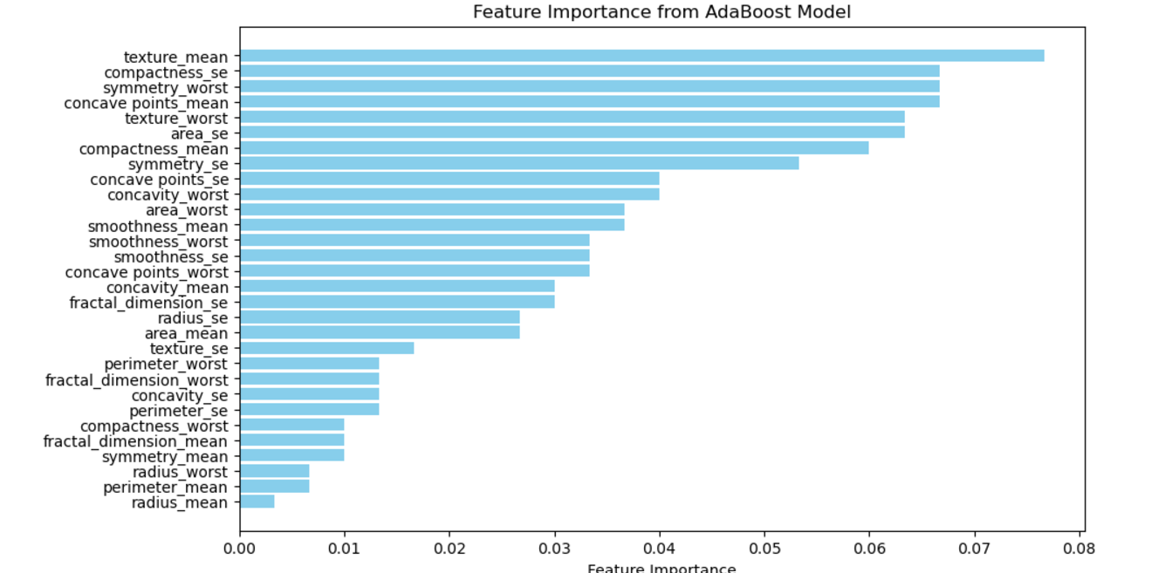
A Cut off of .03 is used for Variable selection
Data Without Smote

Slide 29
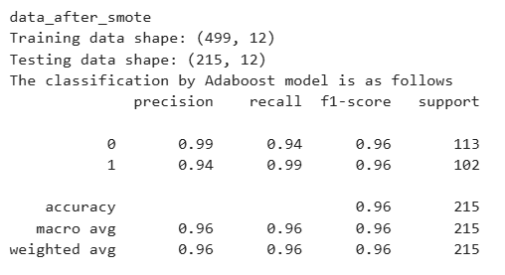
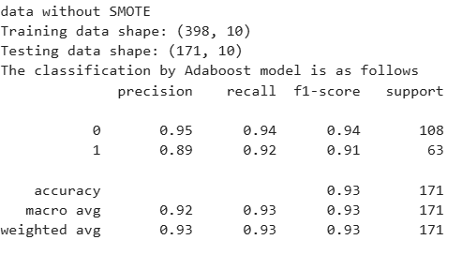
The models are recreated using the importance features and the hyper parameter tuning is also done
The Selected Models is Loaded into Pickle Files, which will be Accessed by the Streamlit App Later

Slide 30

Stream lit Application
-AI BREAST CANCER DIAGNOSTIC ASSISTANT
The AI Breast Cancer Diagnostic Assistant is a powerful tool designed to aid in the diagnosis of breast cancer using patient input features. Utilizing the AdaBoost algorithm, the model achieves an impressive accuracy of 96.28% based on 215 samples. This tool enables healthcare professionals to make accurate and timely diagnostic decisions, significantly enhancing clinical efficiency and patient care.

Slide 31

A diagnostic prediction dashboard that evaluates various input features provided by the user, such as texture, concave points, area, and smoothness. Based on the analysis, the prediction outcome is shown as Benign with a 67.9% confidence level, categorized under "Moderate Confidence Prediction." A probability distribution chart illustrates the confidence split, with 67.9% indicating benign and 32.1% malignant, and it suggests additional testing for confirmation. The dashboard effectively visualizes data to support decision-making.

Slide 32

MODEL PERFORMANCE ANALYSIS
1,ROC CURVE

Slide 33

2.PRECISION-RECALL

Slide 34

3.CONFUSION MATRIX

Slide 35

4. CLASSIFICATION REPORT

Slide 36


Slide 37


